Slide 1
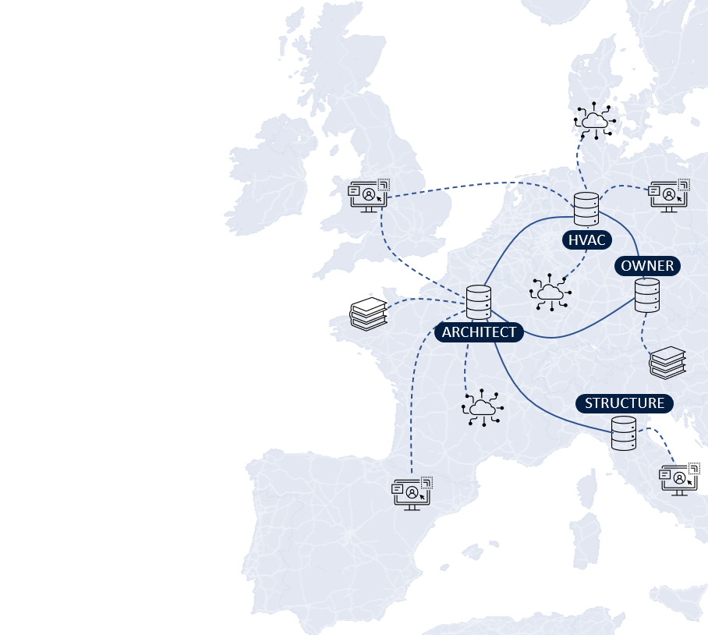
LBDserver A Federated Ecosystem for Heterogeneous Building Data
Jeroen Werbrouck – Pieter Pauwels – Jakob Beetz – Erik Mannens
LBD Community Group presentation – 14/12/2021

Slide 2
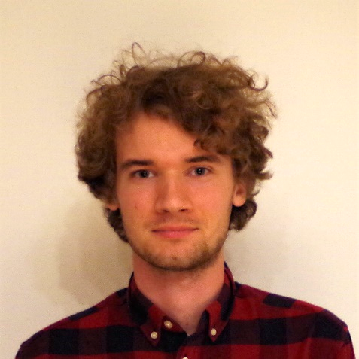
Project background
M. Sc. in Engineering: Architecture (UGent, 2013-2018)
PhD research grant FWO Flanders (2019-…)
Web- and data-based AECO projects
Data federation
Semantic data models (RDF) & sub-document identifiers (no RDF)
Modular, “plugin-based” service infrastructure

Slide 3
introduction

Slide 4
Context: Data Federation in AEC
Project-specific data
Contextual data
Services
Data heterogeneity
Decentralised access control
Sub-document information linking
“Using a 3rd party Web BIM service, the Asset Owner localises a damage pattern on a picture of the Facility Manager, linking it to an existing building element via the as-built 3D model provided by the Architect, and referring to external regulation datasets provided by the government.”

Slide 5
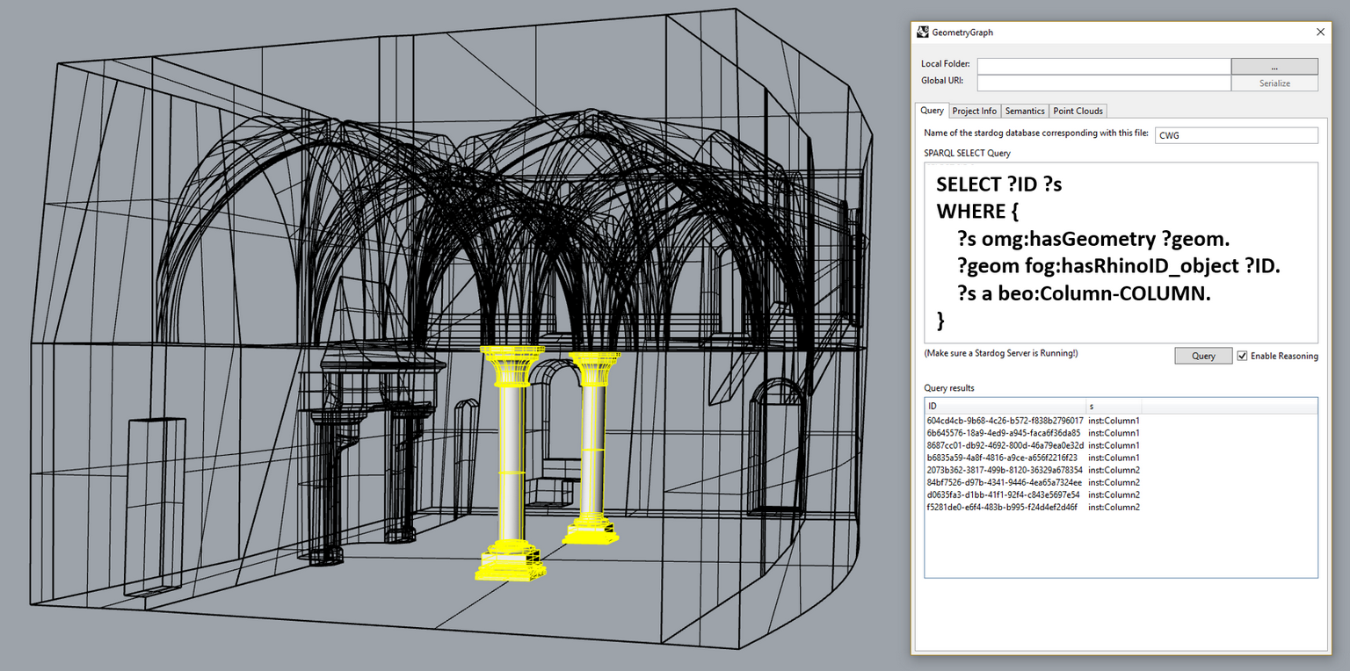
semantic enrichment of heterogeneous data
Scan-to-Graph semantic enrichment of existing building geometry (LBD CG 01/12/2020)
BUT: limited scope
Central data storage (triple store)
Use geometry to access/enrich semantics
EXTENSION:
Federated data storage
Use any resource to access any other resource in the project
https://doi.org/10.1016/j.autcon.2020.103286

Slide 6

Presentation overview
HVAC eng.
Architect
FM
Struc. eng.
1. Project Discovery and storage patterns

Slide 7

Presentation overview
HVAC eng.
Architect
FM
Struc. eng.
2. Federated sub-document linking

Slide 8
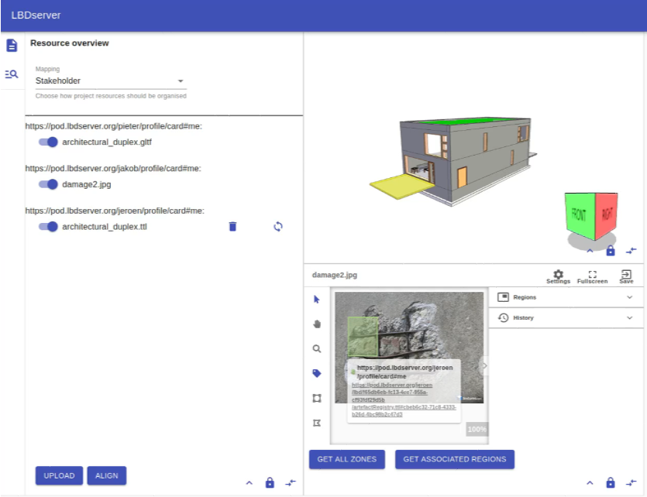

Presentation overview
HVAC eng.
Architect
FM
Struc. eng.
3. Concepts for flexible end-user interaction

Slide 9
1. Data patterns

Slide 10
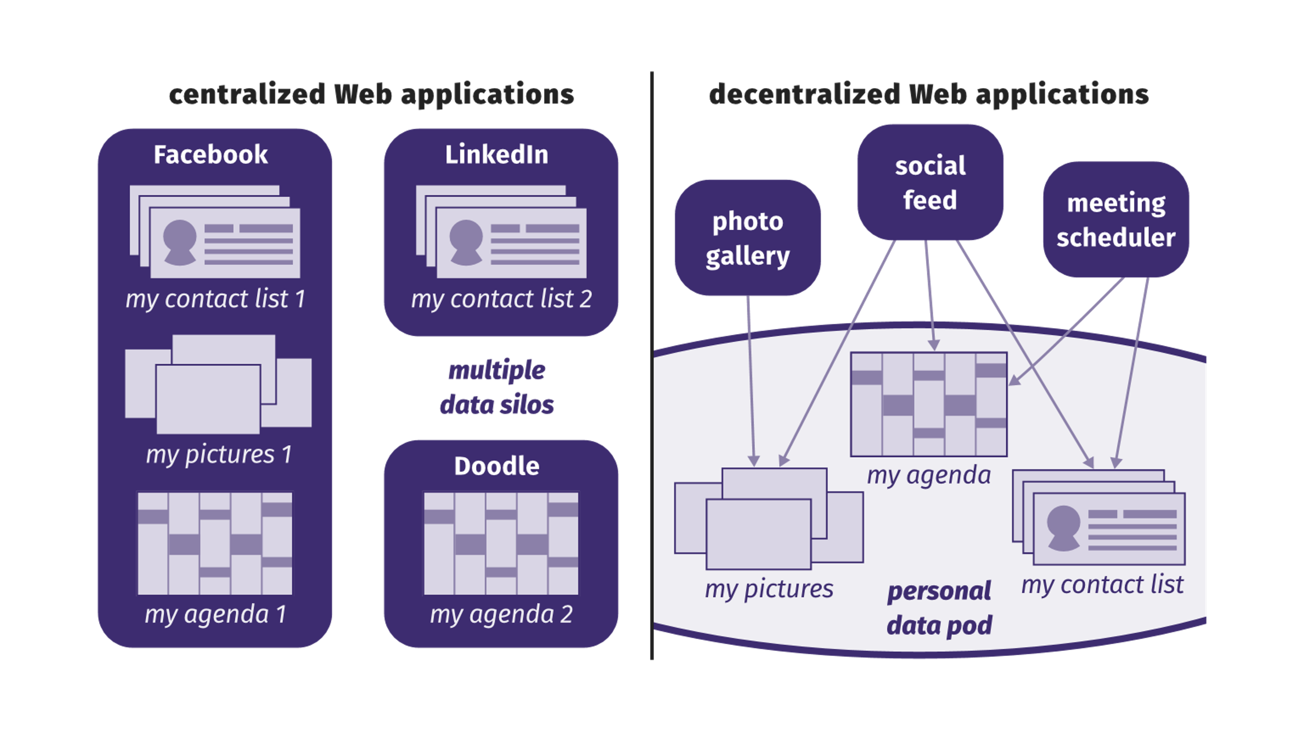
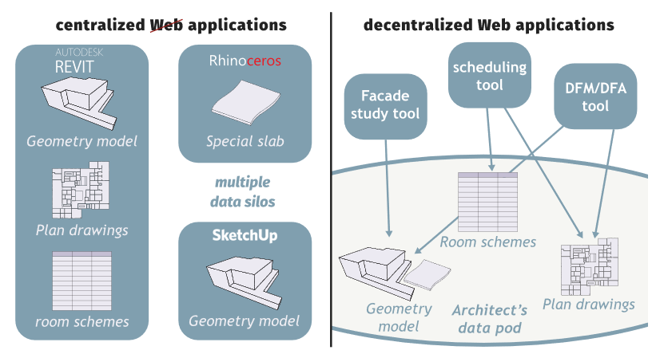
Context: Solid
Web ID: A URL that represents an actor on the Web “Web username”
Data Pod: Personal data storage linked to a Web ID Linked Data Platform (LDP) + AUTH
Identity Provider: Instance hosting your WebID (and Pod) Can be self-hosted
© Ruben Verborgh, 2018
© Mads Holten Rasmussen, 2018
DATA PATTERNS

Slide 11
Solid for aec?
Professional use self-hosting of Pods and WebIDs is possible
WebIDs are public project discovery starts from a WebID
Although projects will be federated, their boundaries can still be well-defined (i.e. limited to the contributions of consortium members)
Boundaries can be defined by every stakeholder separately, as everyone can have their own access point
It should be possible to include information that is not Solid-based.

Slide 12
aggregators
LDP containers with ‘virtual’ subcontainers
Point to project access point URLs LDP containers that aggregate local project contributions of offices
Group projects (public or private) based on specific parameters:
Participation / ownership
the project registry of an office POD
All projects owned by the government
Typology
All libraries in Flanders
All bridges in Germany
…
DATA PATTERNS

Slide 13
Project discovery
{hvac}/profile/card#me
{arch}/profile/card#me
lbd:hasProjectRegistry
/lbd/(.meta)
/lbd/(.meta)
The project registry of a stakeholder is no more than a specific “aggregator”; an LBD container which groups projects where this stakeholder participates in.
ldp:contains
/lbd/{ID}/(.meta*)
(ldp:contains)
/lbd/{ID}/(.meta*)
The project access point is an LDP container which effectively contains the contributions of the stakeholder (/local/), and virtually contains relevant contributions of other stakeholder in the project.
VIRTUAL
ldp:contains
/local/(.meta)
/local/(.meta)
* In Solid, “.meta” files are mapped to specific LDP containers. Dereferencing the container yields the .meta resource.
** By default, “.meta” files in Solid cannot be edited directly. In this case, this restriction was overruled in favor of project organisation
DATA PATTERNS

Slide 14
Project organisation
…
<> dct:creator <https://pod.arch-office.com/profile/card#me> ;
a lbd:PartialProject,
dcat:Catalog ;
lbd:satellite <https://satellite.arch-office.com/> .
lbd:referenceRegistry /
ldp:contains
/local/(.meta)
./references/(.meta)
lbd:datasetRegistry /
ldp:contains
./services/(.meta)
./rules/(.meta)
ldp:contains
ldp:contains
./datasets/(.meta)
ldp:contains
./dataset1/(.meta)
./dataset2/(.meta)
./dataset3/(.meta)
ldp:contains
./distribution1
DATA PATTERNS

Slide 15
datasets
…
<> a dcat:Dataset ;
dct:title “the title of the dataset”;
dcat:keyword “topology” ;
dcat:distribution <distribution1> , <distribution2> .
<distribution1> a dcat:Distribution ;
dc:format <https://www.iana.org/assignments/media-types/text/turtle>;
dcat:downloadUrl </distribution1> .
<distribution2> a dcat:Distribution ;
dcat:accessService serv:service1 ;
dcat:accessURL <http://satellite.arch-office.com/sparql?dataset={URI-of-distribution-1}&query=> .
./dataset1/(.meta)
ldp:contains
./distribution1
!
May refer to Pod-external (contextual) datasets as well
SATELLITE?
DATA PATTERNS

Slide 16

satellites
Solid Pod is the main access point
Sometimes, external services are needed…
APIs / orchestration services:
CRUD project data
Maintain consistency
Provide virtual views on top of datasets
Querying (SPARQL service, time series)
Document store (MongoDB, …)
Require powerfull access control rights! (TRUST)
Pod-specific “Satellites” (one or more)
DATA PATTERNS

Slide 17
2. Sub-document linking

Slide 18
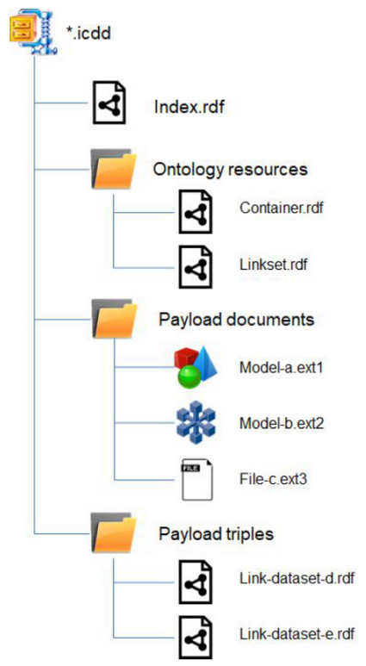
Context: sub-document linking - ICDD
Information Container for linked Document Delivery (ICDD, ISO 21597)
RDF vocabulary to semantically integrate non-RDF resources
ZIP container with dump of entire project
Final point of data exchange
Not a database
Not a CDE
© ISO 21597
SUB-DOCUMENT LINKING

Slide 19
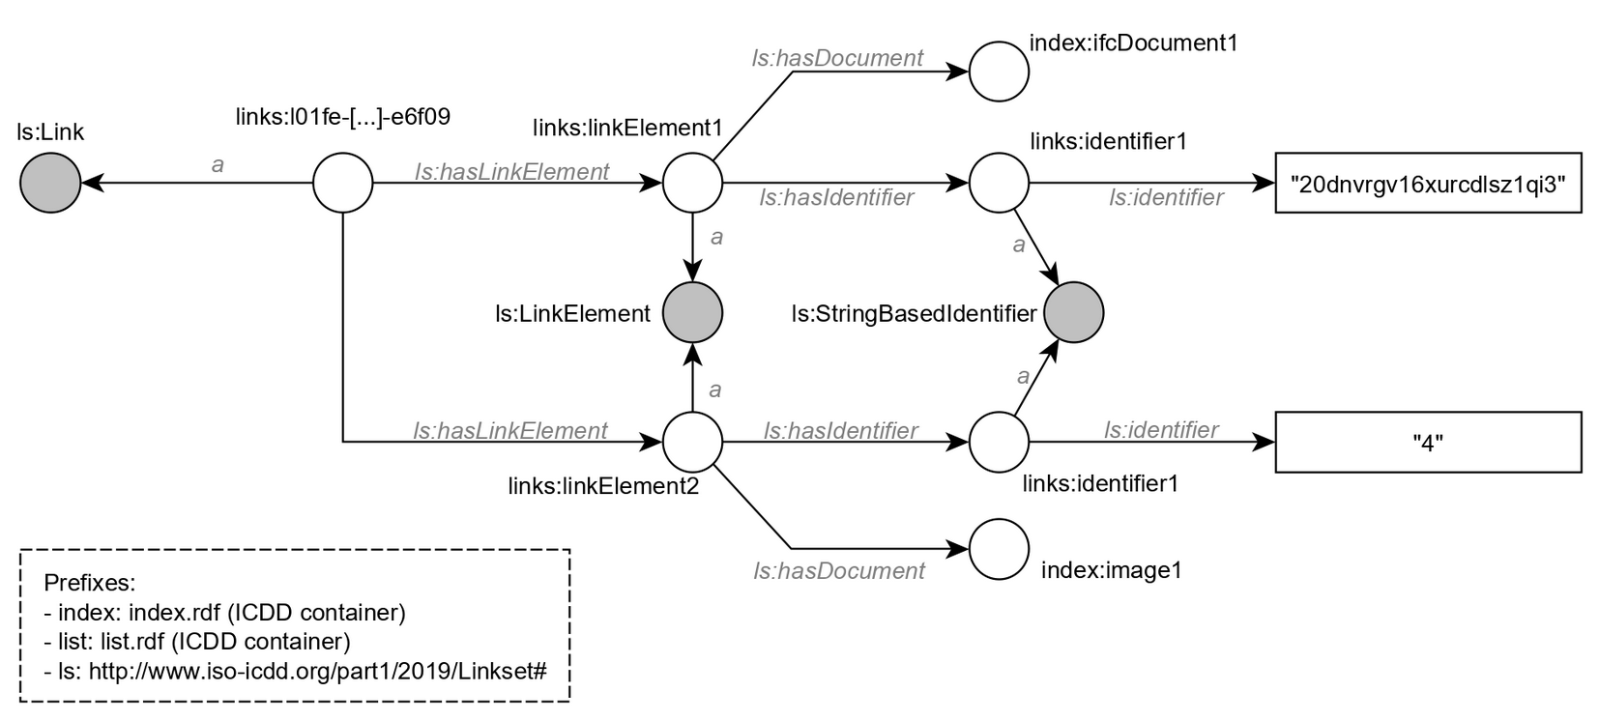
Context: sub-document linking - ICDD
Information Container for linked Document Delivery (ICDD, ISO 21597)
ZIP container with dump of entire project
RDF vocabulary to semantically integrate non-RDF resources
START HERE!
“20dnvrgv16xurcdlsz1qi3”
{“x”: 30, “y”: 15, “w”: 100, “d”: 80 }
SUB-DOCUMENT LINKING

Slide 20
Reference registry
Linking dataset-specific contexts to project-wide “abstract concepts”
Dataset Local project
Local project Global project
Enriching a concept “Door X has parameter P”
Enriching the representation of a concept “Geometry Y, which represents Door X, has an insufficient LOD”
Reference registry = dataset
RDF-based distribution
JSON/BSON
SUB-DOCUMENT LINKING

Slide 21
Concept enrichment: EXAMPLE
ARCHITECT
creates a local concept
Creates a semantic reference where he says this is a wall
Creates a geometric reference of this element
ENGINEER
opens the geometric reference of the architect in a Web Viewer
uses it as a proxy to create a local alias (owl:sameAs) of the concept in his own Reference Registry
creates a semantic reference where he indicates the element’s properties (e.g. U-value 0,4 W/m²K)
…
{other stakeholder}
Uses the aggregation of earlier enrichments for performing own tasks and responsibilities
SUB-DOCUMENT LINKING

Slide 22
Concept enrichment: EXAMPLE
ARCHITECT created a local concept <#concept1>
With a semantic reference: in dataset “/dataset1/” in distribution /dist1$.ttl <#id1> a beo:Wall
With a geometric reference: in dataset “/dataset2/” in distribution /dist2$.gltf “20dnvrgv16xurcdlsz1qi3”
/dataset1/
/dist2.gltf
lbd:inDataset
lbd:inDistribution
lbd:hasReference
#ref1
lbd:hasIdentifier
#identifier1
lbd:hasIdentifier
dist1#id1
Architect’s reference registry
#concept1
lbd:hasReference
#ref2
lbd:hasIdentifier
#identifier2
lbd:hasIdentifier
“20dnv…”
lbd:inDataset
lbd:inDistribution
/dataset2/
/dist2.gltf
SUB-DOCUMENT LINKING

Slide 23
Concept enrichment: EXAMPLE
ENGINEER
opens the geometric reference of the architect (e.g. in a Web Viewer)
uses it as a proxy to derive the abstract concept from the architect’s Reference Registry
creates a local alias (owl:sameAs) of the concept in his own Reference Registry
Informs the satellite of the architect an alias was created (backlinking)
creates a semantic reference where he indicates the element’s properties (e.g. U-value 0,4 W/m²K)
Architect’s reference registry
Engineer’s reference registry
“20dnv…”
[…]
#concept1
owl:sameAs
#concept8
[…]
/dist5#id4
[…]
<#id4> props:hasUValue “0,4” .
dist1#id1
<#id1> a beo:Door .
SUB-DOCUMENT LINKING

Slide 24
Reference enrichment
Say something about the reference itself rather than its contents
Engineer’s reference registry
#concept2
[…]
owl:sameAs
Architect’s reference registry
#concept1
lbd:hasReference
#ref2
lbd:hasIdentifier
#identifier2
lbd:hasIdentifier
“20dnv…”
lbd:inDataset
lbd:inDistribution
/dataset2/
/dist2.gltf
SUB-DOCUMENT LINKING

Slide 25
3. end-user interaction

Slide 26
Context: interaction with data
Service-to-service communication: checking and validation, simulations, …
Design decisions still need GUI
Can we have a dynamically generated GUI?
Based on available project data (geometry, semantics, images, spreadsheets, Web APIs …)
Based on the needs of the task at hand
END-USER INTERACTION

Slide 27
Context: module federation
Webpack 5: Module federation / microfrontends
Standalone plugins, deployed on the Web
Can also be used in configuration with others (Container application)
Run-time loading dynamically load UI depending on needs
Minimal exchange of data between plugins
Auth session
Project ID
“active datasets”
Currently selected elements
List of abstract concepts (see Section 3 [Sub-document Linking])
Plugin ‘knows’ which representations/manifestations it can handle
END-USER INTERACTION

Slide 28
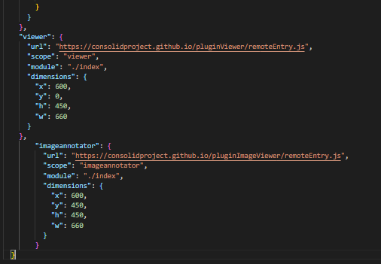
E.g. For task X, I will need:
- a 3D viewer that can display IFC models
- an image annotator
- a SPARQL query module
- …
https://lbd-dev.org/resourceOverview/remoteEntry.js
https://3dsolutions.be/viewerplugin/remoteEntry.js
https://lbd-dev.org/resourceOverview/remoteEntry.js
https://another.comg/imgAnnotate/remoteEntry.js
END-USER INTERACTION

Slide 29
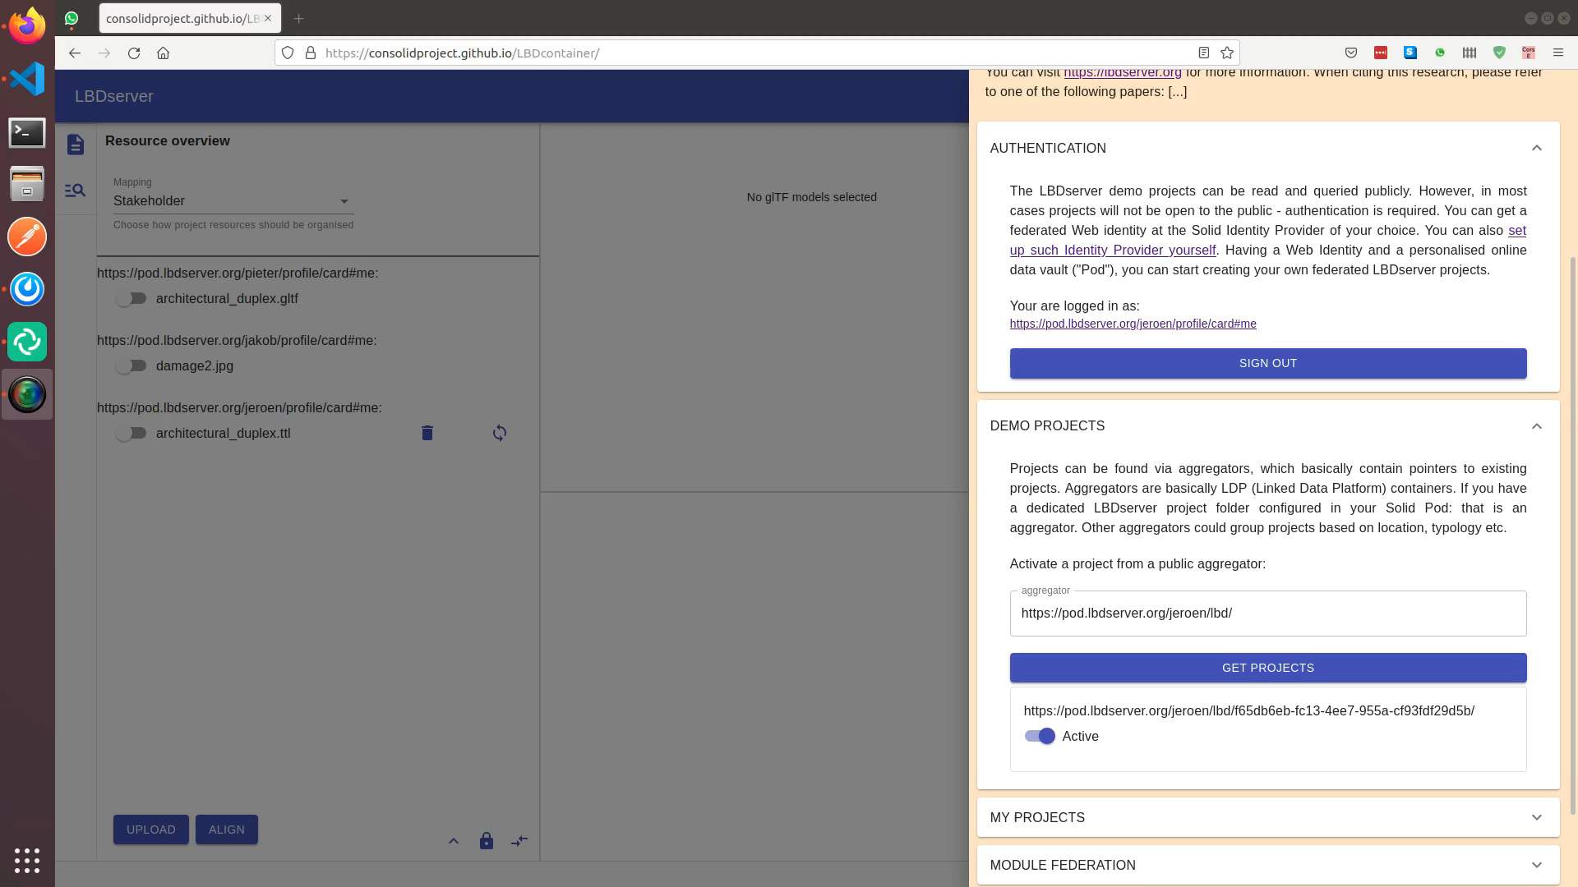
END-USER INTERACTION

Slide 30
4. Proof-of-concept

Slide 31
Try it out
Very experimental!
Small server (limited resources)
http://demo.lbdserver.org

Slide 32
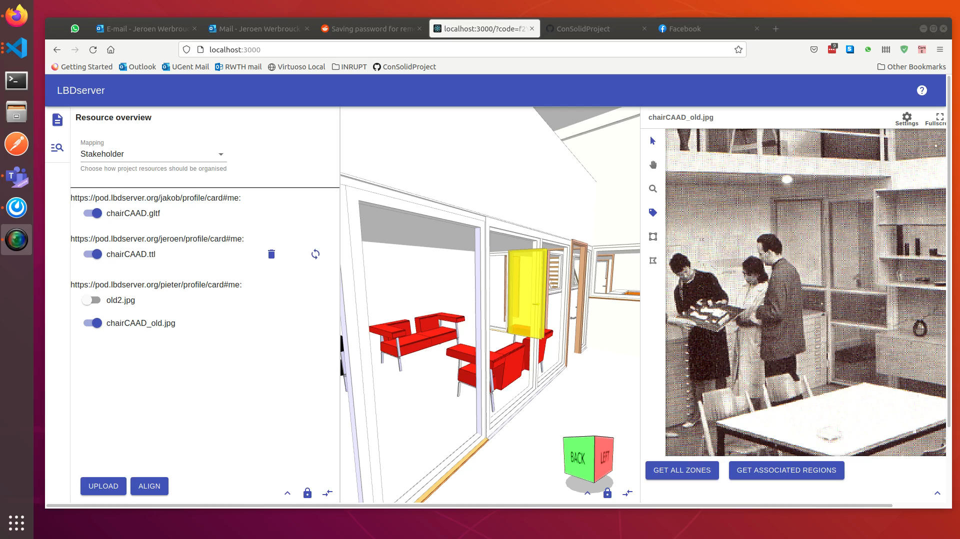
demo I

Slide 33
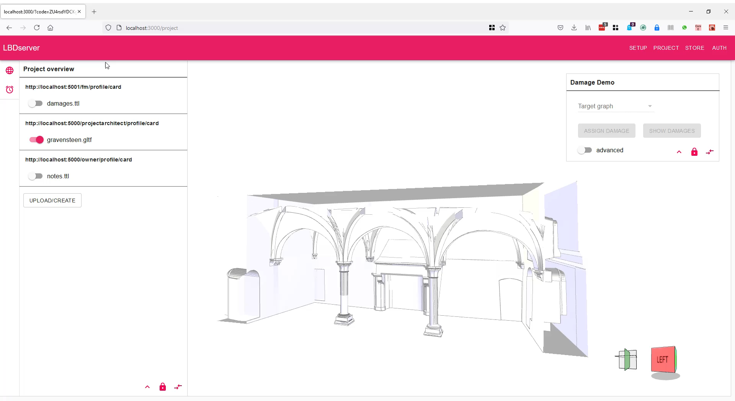
Demo iI
!
Outdated implementation – same concepts

Slide 34
5. conclusion

Slide 35























Technological overview of the LBDserver
DATA FEDERATION
WAC
WebID
LDP
APPLICATION
AECO-STORE
DATA FEDERATION
module federation
SERVICE
FEDERATION
W3C STANDARDS
FRONT-END
FEDERATION
OPEN API
{REST}
GraphQL
DATA INTEGRATION
ICDD
DATA FEDERATION
LBD
BCF

Slide 36
Summary
“Federated multi-model” based on Solid (AUTH) and well-established data storage technologies (DCAT, LDP)
Abstract “things” have dataset-specific representations that can be managed at different stakeholder Pods
Disparate UI modules can communicate with one another using abstract things & filtered manifestations
UI modules of different origin can be configured in a “shopping cart” configuration

Slide 37
Future work
ACADEMIC
How to handle dynamic phases (e.g. design) in contrast with static phases?
Real-time connection & syncing with BIM authoring tools
More standardised API approach, less ad-hoc
Paper: submitting for Special Issue of Semantic Web Journal
IMPLEMENTATION
Publish and document LBDserver backend services (CSS/satellite-API/MongoDB/Fuseki)
Document npm module “consolid” for communication between client and servers
Document creation of micro-front-end modules on top of the LBDserver

Slide 38





Contact
Main Research
Jeroen Werbrouck
PhD Researcher (FWO Flanders)
Ghent University | RWTH Aachen
Jeroen [dot] werbrouck [at] ugent [dot] be
Promotors
Erik Mannens (Ghent University | IMEC )
Pieter Pauwels (Ghent University | TU Eindhoven)
Jakob Beetz (RWTH Aachen)
Project Info
https://lbdserver.org
https://github.com/ConSolidProject/

Slide 39
THANK YOU!

Slide 40
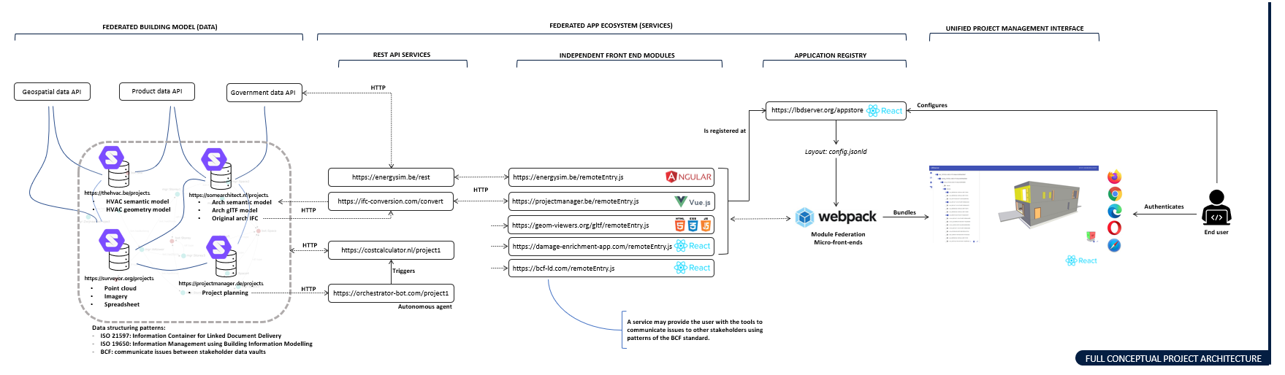
overview

Slide 41
reference Registry: local
hasLinkElement
arch: art1
own:art8
lbd:hasReference
hasDocument
le1
hasIdentifier
Lbd:inDataset
hasIdentifier
le3
arch.ttl
id1
fm:art5
identifier
model.gltf
id3
</arch.ttl#door1>
identifier
arch:artefactRegistry.ttl
“Brep 1”
own:artefactRegistry.ttl
hasLinkElement
hasDocument
le2
hasIdentifier
damage.ttl
id2
identifier
</damage.ttl#element1>
fm:artefactRegistry.ttl
@prefix arch: <https://archoffice.de/lbd/abc123/> .
@prefix fm: <https://fm-bureau.fr/lbd/abc123/> .
@prefix own: <https://pod.inrupt.net/lbd/abc123/> .

Slide 42
reference Registry: global alignment
hasLinkElement
arch: art1
own:art8
lbd:hasReference
hasDocument
owl:sameAs
le1
hasIdentifier
Lbd:inDataset
hasIdentifier
le3
arch.ttl
id1
fm:art5
identifier
model.gltf
id3
</arch.ttl#door1>
identifier
arch:artefactRegistry.ttl
“Brep 1”
own:artefactRegistry.ttl
hasLinkElement
hasDocument
le2
hasIdentifier
damage.ttl
id2
identifier
</damage.ttl#element1>
fm:artefactRegistry.ttl
@prefix arch: <https://archoffice.de/lbd/abc123/> .
@prefix fm: <https://fm-bureau.fr/lbd/abc123/> .
@prefix own: <https://pod.inrupt.net/lbd/abc123/> .

